Slide 1
Latent variable model for neural population analysis
分享人：孙华琴
2024.01.12

Slide 2
一、 研究背景与目标
背景：
大规模的神经记录让基于单个神经元的神经特性分析面临挑战
单次trial的神经数据变化是有用信息，而基于单个神经元的分析多是trial的平均，这会导致信息损失[1]
神经元间存在协调反应的相互作用，使得单个神经元的反应非常复杂，难以分析[1]
将高维数据降维到几个可解释的latent有助于数据分析[2]
目标-数据分析：
在低维的latent上会有有意义的表征
对应的结果：
确实学到了有效表征（比别的方法更好的表征，表现在重构和泛化的指标更好）
无监督的表征与行为数据有相关性-新发现
方法的创新的话：符合假设/新约束的结果出现
[1] Cunningham J P, Yu B M. Dimensionality reduction for large-scale neural recordings[J]. Nature neuroscience, 2014, 17(11): 1500-1509.
[2] Hurwitz C, Kudryashova N, Onken A, et al. Building population models for large-scale neural recordings: Opportunities and pitfalls[J]. Current opinion in neurobiology, 2021, 70: 64-73..

Slide 3
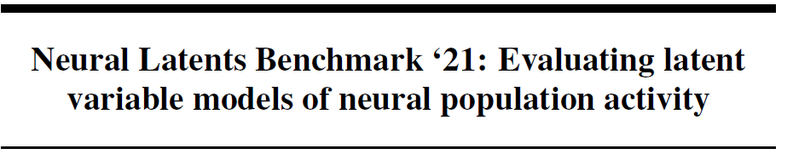
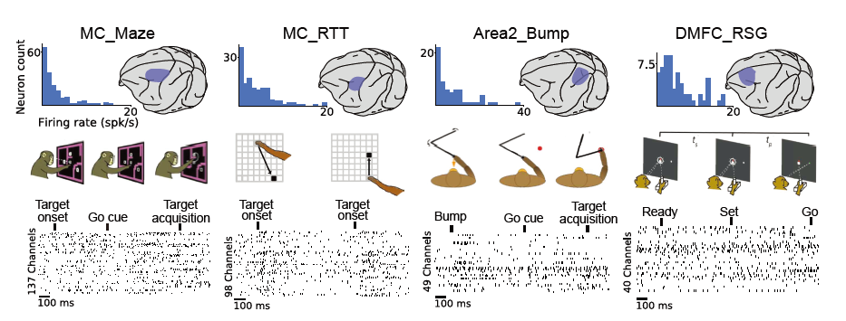
二、 公开数据集
Pei F, Ye J. Neural Latents Benchmark ‘21: Evaluating latent variable models of neural population activity[C]//35th Conference on Neural Information Processing Systems. 2022.

Slide 4
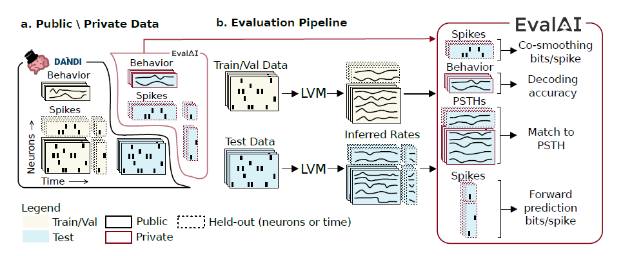
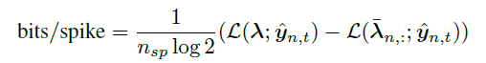
二、 公开数据集
Co-smoothing
Behavioral decoding
Match to PSTH
Forward prediction
Pei F, Ye J. Neural Latents Benchmark ‘21: Evaluating latent variable models of neural population activity[C]//35th Conference on Neural Information Processing Systems. 2022.

Slide 5
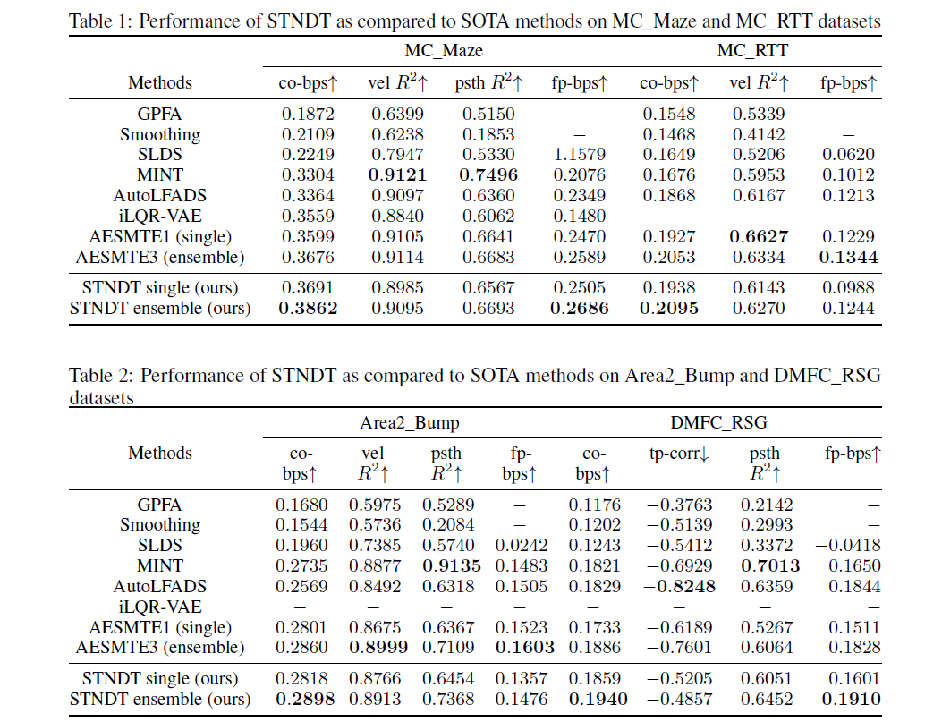
二、 公开数据集
Pei F, Ye J. Neural Latents Benchmark ‘21: Evaluating latent variable models of neural population activity[C]//35th Conference on Neural Information Processing Systems. 2022.

Slide 6
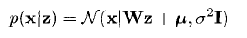
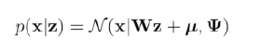
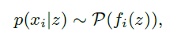
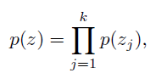






二、模型发展脉络
PCA
FA
Static model：
Observation function：
+linear：PCA, FA
+non-linear: AE, VAE
++simple tuning sharing+ ensemble: faeLVM (2023-ICLR)
z
Latent information(增加disentanglement)：
+task information: pi-VAE (2020-NeurIPS), dPCA
+self-supervised learning: SwapVAE(2021-NeurIPS)
++simple tuning + ensemble: faeLVM (2023-ICLR)
x
Dynamic model:
Modeling the latent trajectories：
State Space representation: Explicit Evolution function
Moment representation:
the statistics of latent trajectories (GP),
the relationship of timesteps (contrastive learning)
Mask modelling based(transformer-based model)
$$z_{1}$$
$$z_{2}$$
$$z_{3}$$
$$x_{1}$$
$$x_{2}$$
$$x_{3}$$
[1] Hurwitz C, Kudryashova N, Onken A, et al. Building population models for large-scale neural recordings: Opportunities and pitfalls[J]. Current opinion in neurobiology, 2021, 70: 64-73..

Slide 7
二、Static model
PCA
FA
Static model：
Observation function：
+linear：PCA, FA
+non-linear: AE, VAE
++simple tuning sharing+ ensemble: faeLVM (2023-ICLR)
z
Latent information(增加disentanglement)：
+task information: pi-VAE (2020-NeurIPS), dPCA
+self-supervised learning: SwapVAE(2021-NeurIPS)
++simple tuning + ensemble: faeLVM (2023-ICLR)
x
model | Mapping function | Observation | Addition information
PCA | Linear | Gaussian | Isotropic covariance
FA | Linear | Gaussian | Diagonal covariance
AE，VAE | NN | Gaussian | No
faeLVM (2023-ICLR) | Ensemble simple tuning | Poisson | No
dPCA | Linear | Gaussian | Task information
pi-VAE (2020-NeurIPS) | NN | Poisson | Task information
SwapVAE(2021-NeurIPS) | NN | Poisson | Self-supervised
Mapping function从非线性到线性，以及更具有可解释性
加入任务信息解缠
模型优化解缠

Slide 8
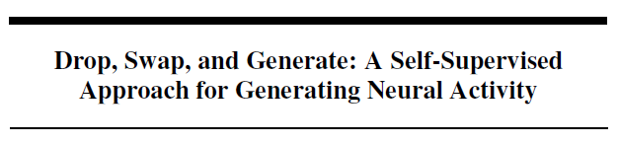
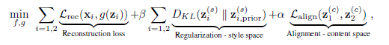
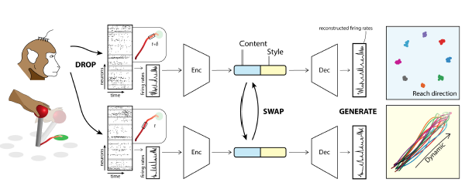
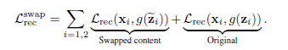
swapVAE-method
基于生成网络的自监督对比学习，增强latent的disentanglement

Slide 9
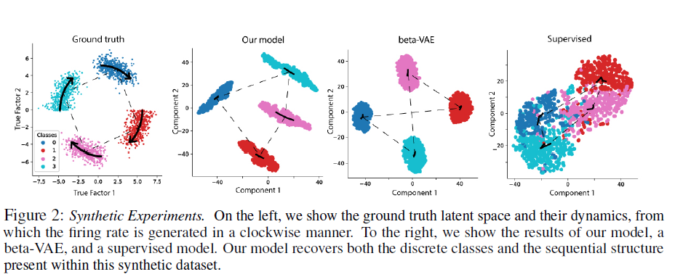
SwapVAE-result
仿真实验上，
预测的latent保持了离散的label和时序信息

Slide 10
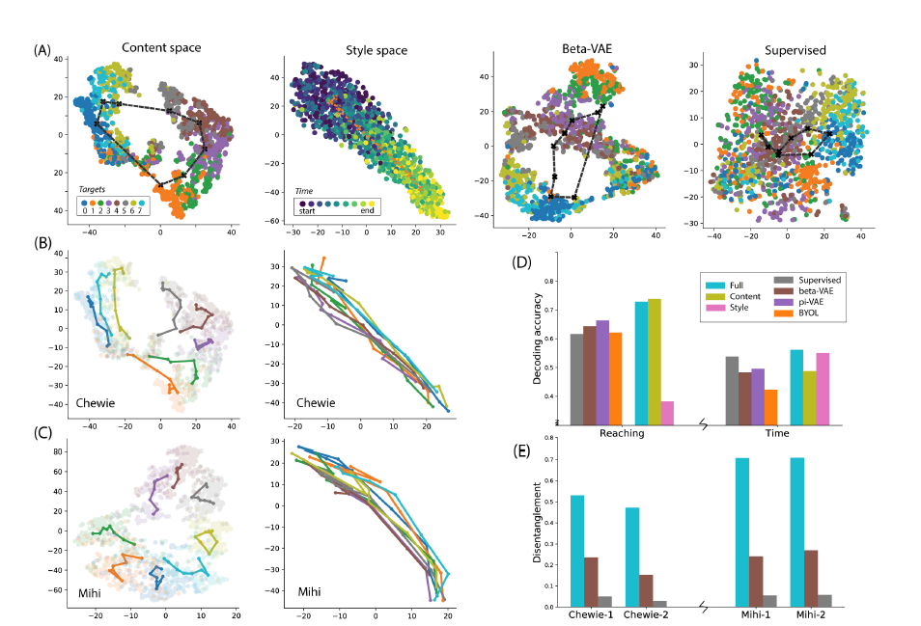
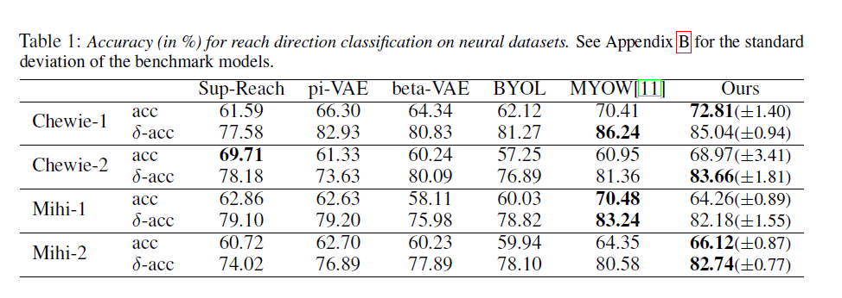
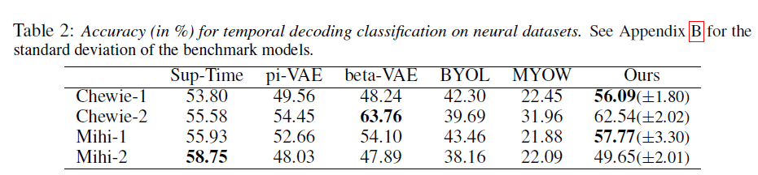
SwapVAE-result
真实数据上，
比别的方法更好的解缠的latent（A，B，C）
Latent与行为数据相关且比别人好（D +Table ）
定量的比较解缠效果（E）

Slide 11
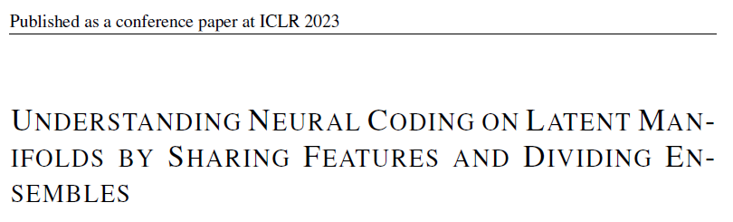
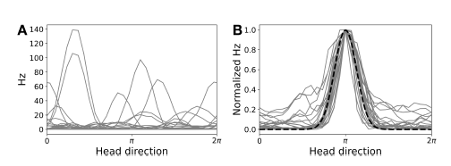
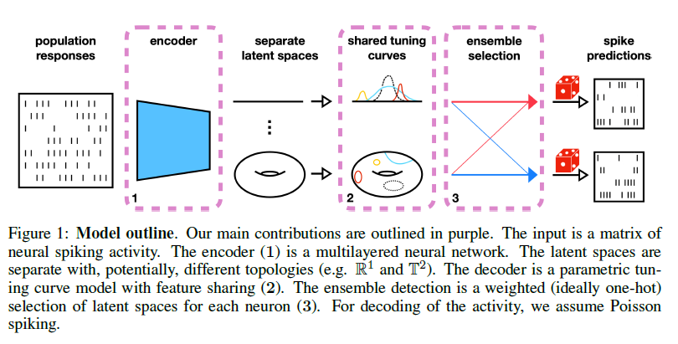
faeLVM-method
约束latent model的observation function使得简单好解释
将nn换成tuning curve
Ensemble feature sharing的神经元群里形成不同group

Slide 12
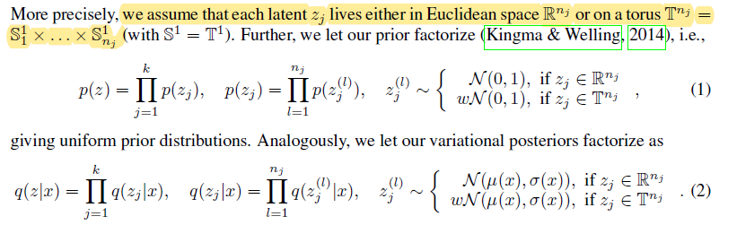
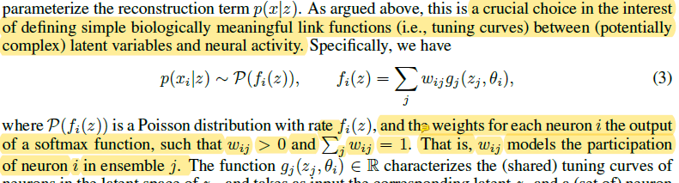
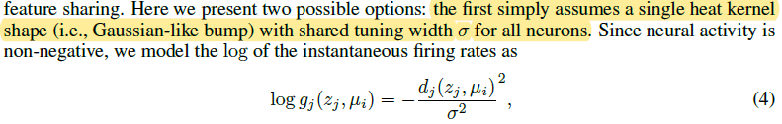
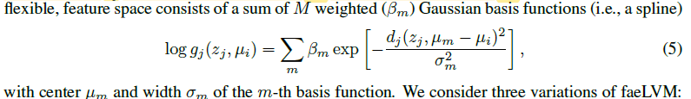
faeLVM-method
约束latent model的observation function使得简单好解释
将nn换成simple tuning curve
Ensemble feature sharing的神经元群里形成不同group

Slide 13
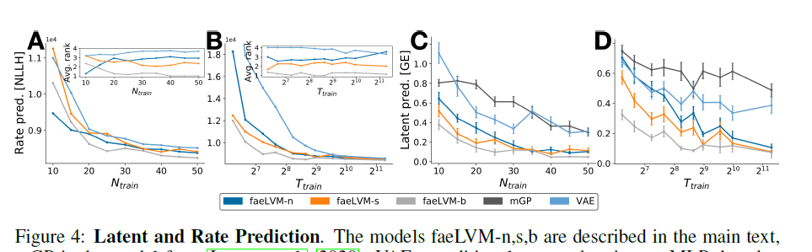
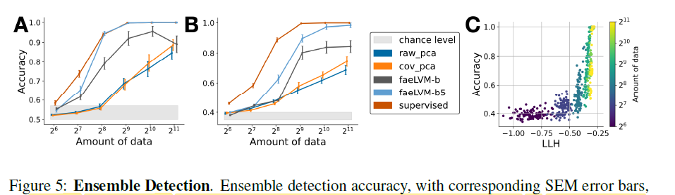
faeLVM-result
仿真实验上，
预测的fr，以及latent更优
仿真实验上，
与模型假设相关的ensemble的准确性

Slide 14
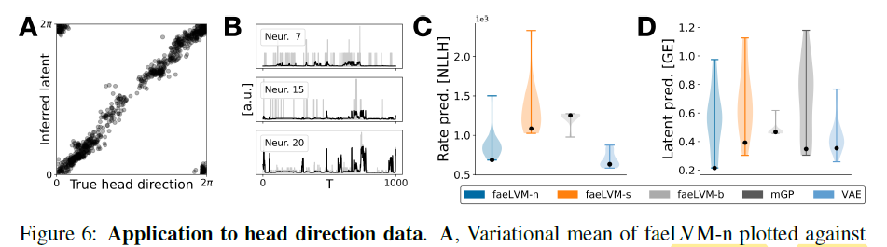
faeLVM-result
真实数据上（已知latent的物理意义，easy版本-不具有ensemble特性，只对head的方向有tuning）：
学到的latent与行为相关（A）；
预测的fr（B,C），以及latent（D）更优

Slide 15
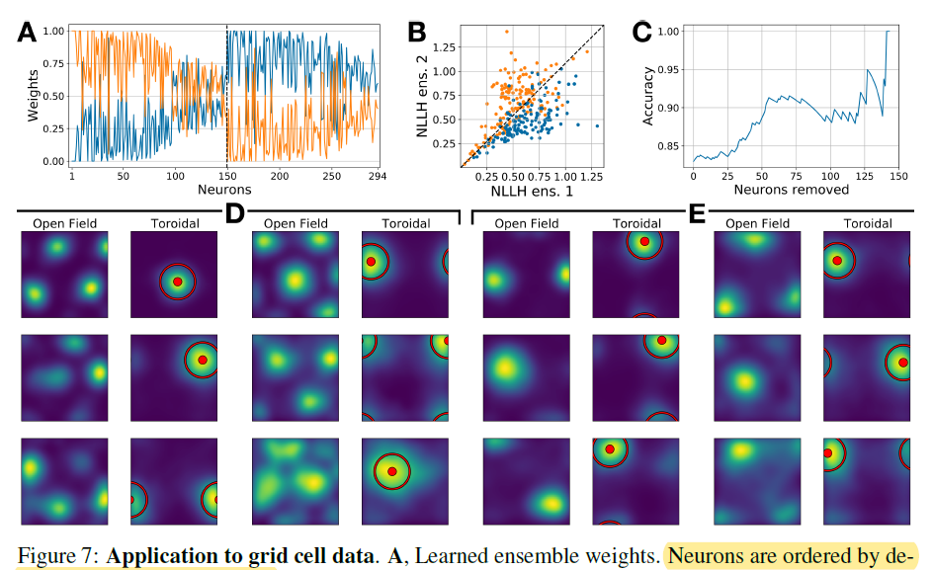
faeLVM-result
真实数据上（已知latent的物理意义，hard版本-具有ensemble特性，对于space，head direction，speed），
模型的ensemble假设成功学到（A,B,C）；
预测的参数确实与行为数据（tuning表现）相关（D,E）
Notes:
自由移动大鼠（Gardner等人，2022）记录的中间内侧海马皮层（MEC）数据；挑选了，使用标记为module-2和modual-3的神经元进行记录，分别考虑了149个和145个非联合神经元

Slide 16
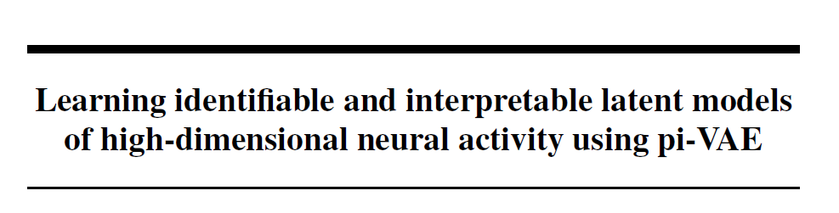
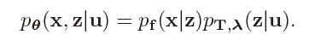
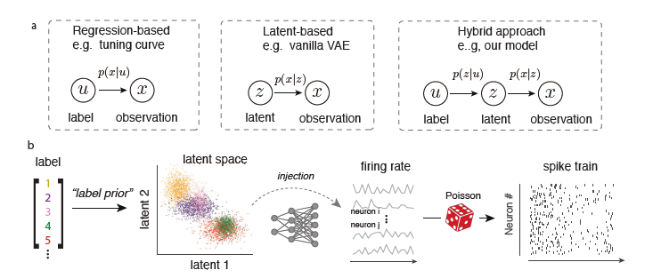
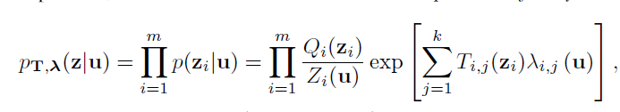
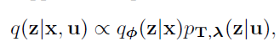
pi-VAE-method
结合tuning model（任务回归神经信号，可解释但underfitting）和latent model（低维latent还原神经信号，表征的信息多但是难以解释）
得到的latent model使得表征更加可解释和可识别

Slide 17
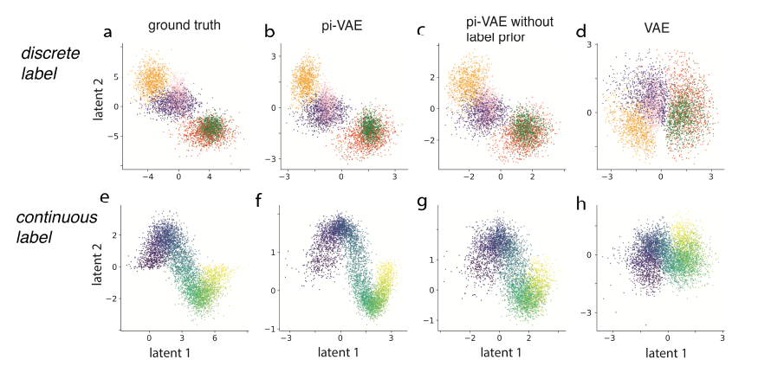
Pi-VAE-result
仿真实验上，
预测的离散和连续的latent更优

Slide 18
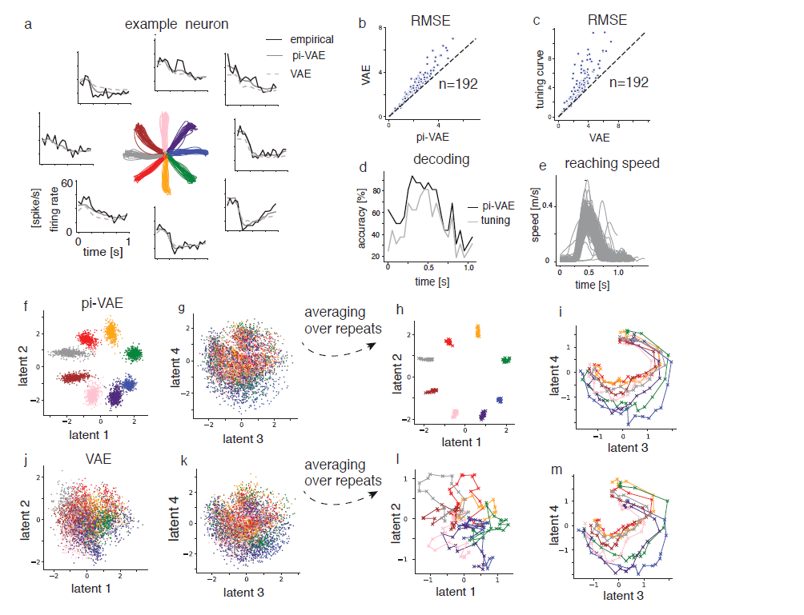
Pi-VAE-result
真实数据上，
可以预测fr（a）
且比别的方法更优（b，c）
学到的latent与行为相关（d,e）
可以预测latent，具有一定解释性（f,g,h,i），
且比别的方法更优(j,k,l,m)

Slide 19
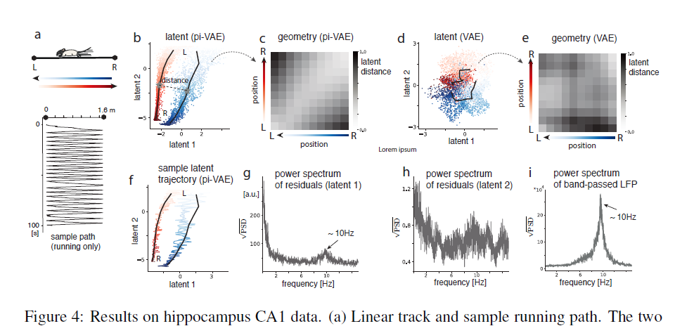
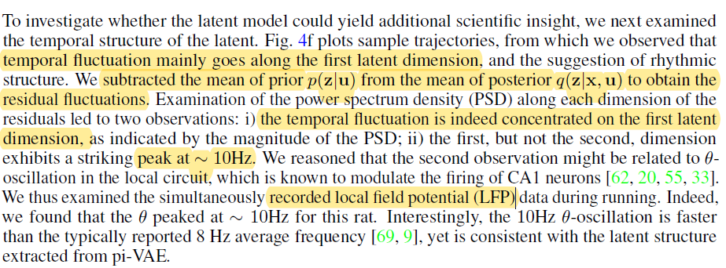
Pi-VAE-result
真实数据上，发现了新的结构
数据（a）
学到的latent与行为相关（b,c）
且比别的方法更优（d,e）
学到的latent有物理意义
Latent1有节律（f,g,h,i）
Latent2表示位置（f）

Slide 20
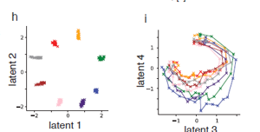
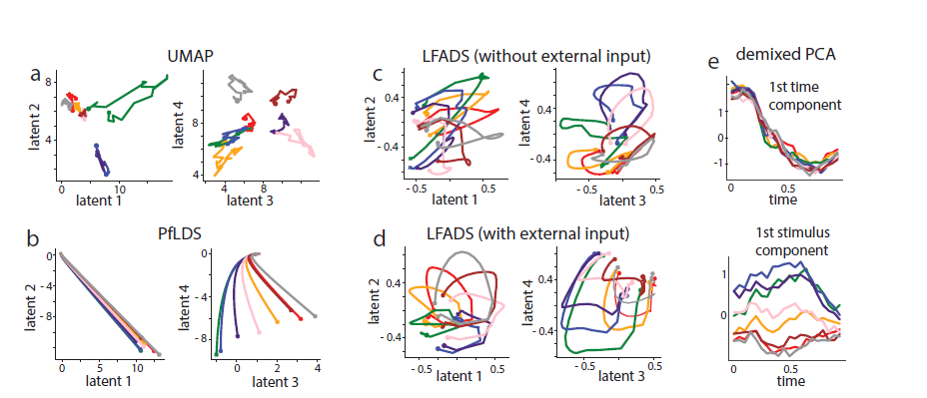
Pi-VAE-result
与现有方法比较
我们的方法更具有可解释性，单个latent的物理意义明确
UMAP-supervise nonlinear：无时序信息
LFADS,PfLDS: smooth but entangled
dPCA: entangled time and directions

Slide 21
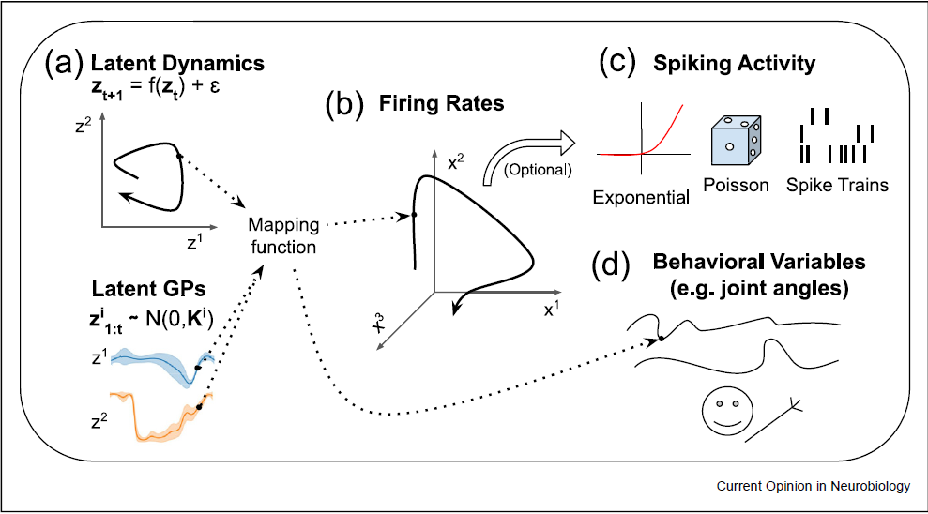
三、dynamic model
Modeling the latent trajectories：
State Space representation: Explicit Evolution function
Moment representation:
the statistics of latent trajectories(GP),
the relationship of timesteps (contrastive learning)
[1] Hurwitz C, Kudryashova N, Onken A, et al. Building population models for large-scale neural recordings: Opportunities and pitfalls[J]. Current opinion in neurobiology, 2021, 70: 64-73..

Slide 22
四、State space representation
Explicit Evolution function:
State Space representation
Trajectories
+Linear：jPCA (2012-Nature)，PLDS (2011-NeurIPS)
+Switch-linear：SLDS (2011-NeurIPS), rSLDS (2017-AIStat, 2020-ICLM)
+NN: LFADS (2018-Nature), AutoLFADS (2022-Nature Methods)，
Latent information (增加disentanglement)：
+task information: PSID (2021,NN), TNDM(2021-NeurIPS)
++input information: IPSID (2023, bioRxiv)
+ latent distribution: SNLVM (2022-TNSRE)
Observation function：
+NN：PfLDS（2011-NeurIPS）
[1] Hurwitz C, Kudryashova N, Onken A, et al. Building population models for large-scale neural recordings: Opportunities and pitfalls[J]. Current opinion in neurobiology, 2021, 70: 64-73..

Slide 23
四、State space representation
model | Dynamics | Mapping function | Observation | Addition information
jPCA (2012-Nature) | Linear+scew | Linear | Gaussian | No
PLDS (2011-NeurIPS) | Linear | Linear | Poisson | No
SLDS (2011-NeurIPS) | Switch-linear | Linear | Gaussian | No
rSLDS (2017-AIStat, 2020-ICLM) | Recurrent switch-linear | Linear | Gaussian | No
LFADS (2018-Nature) | RNN | Linear | Poisson | No
PfLDS（2011-NeurIPS） | Linear | NN | Poisson | No
PSID (2021-NN) | Linear | Linear | Poisson | Behavior projection
IPSID (2023-bioRxiv) | Linear+input dynamics | Linear | Poisson | Behavior projection
TNDM(2021-NeurIPS) | RNN | Linear | Poisson | Behavior decoding
AutoLFADS (2022-Nature Methods) | RNN | Linear | Poisson | Mask enhancement
SNLVM (2022-TNSRE) | RNN | Linear | Poisson | Latent distribution
Dynamics从linear到nonlinear的进化
Mapping function
加入行为信息来解缠
模型优化
[1] Hurwitz C, Kudryashova N, Onken A, et al. Building population models for large-scale neural recordings: Opportunities and pitfalls[J]. Current opinion in neurobiology, 2021, 70: 64-73..

Slide 24
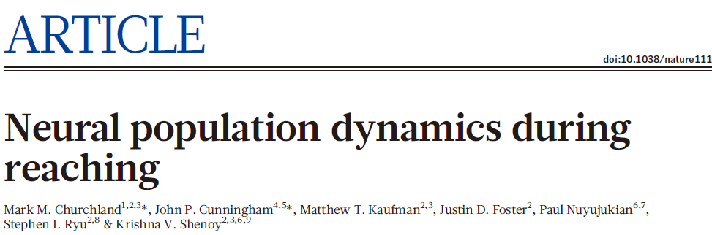
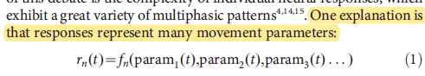
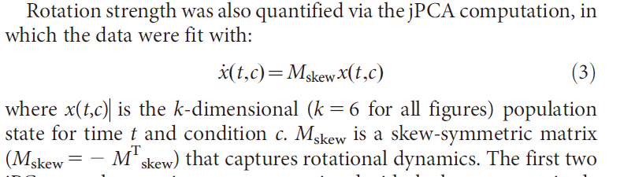
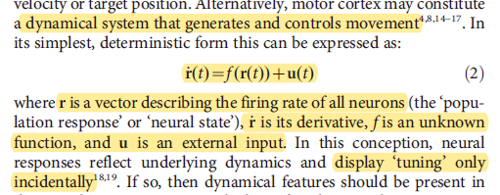
jPCA-method
对于神经数据的多相反应的一个解释
非节律运动的神经信号中也存在节律反应
Schneider S, Lee J H, Mathis M W. Learnable latent embeddings for joint behavioural and neural analysis[J]. Nature, 2023: 1-9.

Slide 25
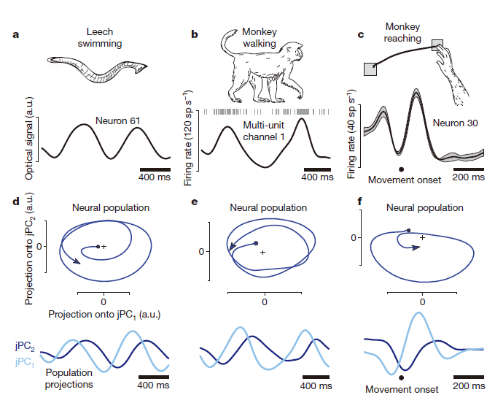
jPCA-result
对于节律运动中，单个神经元展示出相似的震荡(a,b)
根据运动生成的假设，可以学到rotation的latent（d,e）
然而非节律运动，也存在蕾西的准震荡特性（c,f）
Churchland M M, Cunningham J P, Kaufman M T, et al. Neural population dynamics during reaching[J]. Nature, 2012, 487(7405): 51-56..

Slide 26
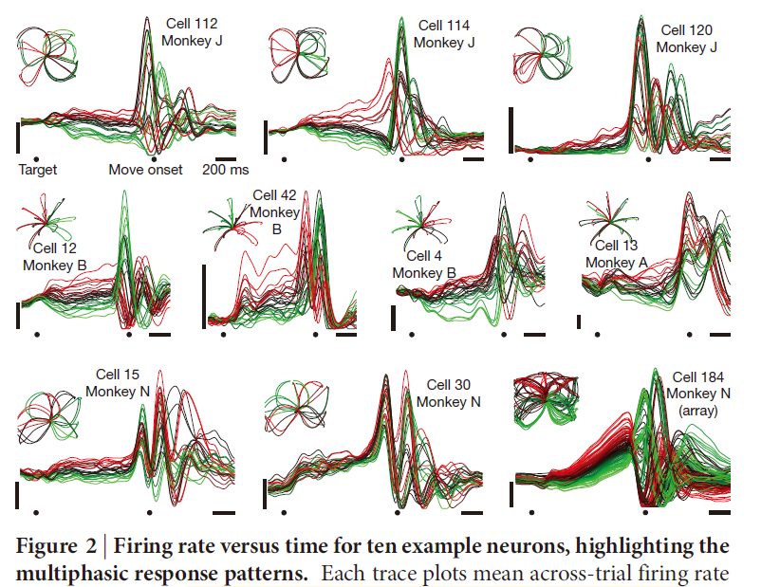
jPCA-result
神经元的反应与prepare和move有关，且多样，复杂
但是，似乎都存在1-1.5个周期的震荡在运动开始前开始
Churchland M M, Cunningham J P, Kaufman M T, et al. Neural population dynamics during reaching[J]. Nature, 2012, 487(7405): 51-56..

Slide 27
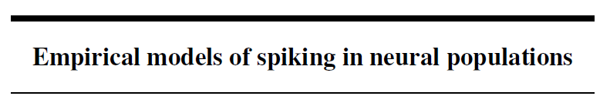
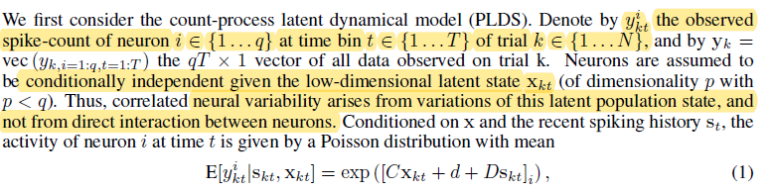
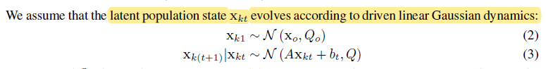
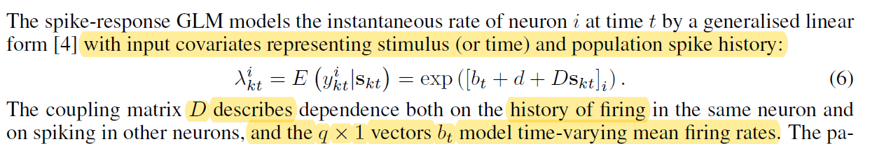
PLDS-method
Advances in neural information processing systems, 2011, 24.
从spike-response GLM到latent variable model
Macke J H, Buesing L, Cunningham J P, et al. Empirical models of spiking in neural populations[J]. Advances in neural information processing systems, 2011, 24.

Slide 28

PLDS-method-补充材料
PLDS很好的教程，包括几种求解的方式
Macke J H, Buesing L, Sahani M. Estimating state and parameters in state space models of spike trains[J]. Advanced state space methods for neural and clinical data, 2015, 137.

Slide 29





SLDS-method
Advances in neural information processing systems, 2011, 24.
多段线性近似非线性
Petreska B, Yu B M, Cunningham J P, et al. Dynamical segmentation of single trials from population neural data[J]. Advances in neural information processing systems, 2011, 24.

Slide 30



SLDS-result
定量结果比较，比baseline强
模型特点，switch有效进行
Petreska B, Yu B M, Cunningham J P, et al. Dynamical segmentation of single trials from population neural data[J]. Advances in neural information processing systems, 2011, 24.

Slide 31





rSLDS-method
Artificial Intelligence and Statistics, 2011, 24.
离散的state中建立了对于前一步的连续state的依赖，
Linderman S, Johnson M, Miller A, et al. Bayesian learning and inference in recurrent switching linear dynamical systems[C]//Artificial Intelligence and Statistics. PMLR, 2017: 914-922.

Slide 32




rSLDS-v2-method
为rSLDS找了个非常合适的应用场景：感知决策
感知决策：利用感官信息做出分类选择的过程。具体：随着时间的推移，有利于决策的证据不断积累，直到跨越阈值或边界，做出决策
确定随机移动点云的净运动方向
Zoltowski D, Pillow J, Linderman S. A general recurrent state space framework for modeling neural dynamics during decision-making[C]//International Conference on Machine Learning. PMLR, 2020: 11680-11691.

Slide 33

rSLDS-v2-method
确定随机移动点云的净运动方向
Zoltowski D, Pillow J, Linderman S. A general recurrent state space framework for modeling neural dynamics during decision-making[C]//International Conference on Machine Learning. PMLR, 2020: 11680-11691.

Slide 34


Compare
模型：Linear Dynamical System model (LDS)
假设：低维隐表征符合某种动力学，可以随时间线性演化
假设：用多个分段线性逼近复杂的系统非线性
假设：下一时刻的离散隐状态不仅与当前时刻的离散隐状态有关，还与连续隐状态有关
模型：Switching Linear Dynamical System model
模型：recurrent Switching Linear Dynamical System model (rSLDS)

Slide 35


LFADS-method
用NN来建模dynamic system间的演化以及observation function从而较好的还原单次trial的动态性
假设单次trial的动态性依赖于：
Underlying dynamics which is complicated
Trial-specific initial conditions
Unmeasured inputs (noise)
Spiking variability distribution of Poisson
Pandarinath C, O’Shea D J, Collins J, et al. Inferring single-trial neural population dynamics using sequential auto-encoders[J]. Nature methods, 2018, 15(10): 805-815.

Slide 36


AutoLFADS-method
由于LFADS（ANNs）调参困难，引入了一种mask的策略来去掉一种模型坍缩的可能性
Keshtkaran M R, Sedler A R, Chowdhury R H, et al. A large-scale neural network training framework for generalized estimation of single-trial population dynamics[J]. Nature Methods, 2022, 19(12): 1572-1577.

Slide 37


TNDM-method
在latent中加入行为信息增加disentanglement
Hurwitz C, Srivastava A, Xu K, et al. Targeted neural dynamical modeling[J]. Advances in Neural Information Processing Systems, 2021, 34: 29379-29392.

Slide 38


SNLVM-method
假设隐变量的分布在符合hyperspherical latent space
Huang Y, Yu Z L. Associating Latent Representations With Cognitive Maps via Hyperspherical Space for Neural Population Spikes[J]. IEEE Transactions on Neural Systems and Rehabilitation Engineering, 2022, 30: 2886-2895.

Slide 39

Compare

Slide 40


SNLVM-result
猴子reach的数据上，
预测的神经信号,PSTH
和行为解码更优
Latent的空间更加合理（1列和2列，更加紧凑以及和行为的拓扑更像）
Latent dynamics更加合理（variance小， 且每个latent都具有dynamics）
Huang Y, Yu Z L. Associating Latent Representations With Cognitive Maps via Hyperspherical Space for Neural Population Spikes[J]. IEEE Transactions on Neural Systems and Rehabilitation Engineering, 2022, 30: 2886-2895.

Slide 41

SNLVM-result
猴子reach的数据上，泛化到held-out方向的能力更优
Huang Y, Yu Z L. Associating Latent Representations With Cognitive Maps via Hyperspherical Space for Neural Population Spikes[J]. IEEE Transactions on Neural Systems and Rehabilitation Engineering, 2022, 30: 2886-2895.

Slide 42


SNLVM-result
消融实验说明参数的影响
消融实验说明latent空间假设的重要性（都不解码行为）
Huang Y, Yu Z L. Associating Latent Representations With Cognitive Maps via Hyperspherical Space for Neural Population Spikes[J]. IEEE Transactions on Neural Systems and Rehabilitation Engineering, 2022, 30: 2886-2895.

Slide 43




PfLDS-method
Advances in neural information processing systems, 2016, 24.
把观测函数改成nn
Gao Y, Archer E W, Paninski L, et al. Linear dynamical neural population models through nonlinear embeddings[J]. Advances in neural information processing systems, 2016, 29.

Slide 44




PfLDS-result
仿真线性的观测函数时，虽然观测函数的是nn，但效率不会变差
仿真：非线性的观测函数，和线性dynamics，效果优于baseline
Gao Y, Archer E W, Paninski L, et al. Linear dynamical neural population models through nonlinear embeddings[J]. Advances in neural information processing systems, 2016, 29.

Slide 45



PfLDS-result
带节律的真实数据上：可视化latent和behavior的关系，以及定量的predictive的性能
不带节律的真实数据上：可视化latent和behavior的关系，以及定量的predictive的性能
Gao Y, Archer E W, Paninski L, et al. Linear dynamical neural population models through nonlinear embeddings[J]. Advances in neural information processing systems, 2016, 29.

Slide 46


PSID-method
将行为相关的neural dynamics通过投影的方式提出出来
Sani O G, Abbaspourazad H, Wong Y T, et al. Modeling behaviorally relevant neural dynamics enabled by preferential subspace identification[J]. Nature Neuroscience, 2021, 24(1): 140-149.

Slide 47



PSID-method
将行为相关的neural dynamics通过投影的方式提出出来
Sani O G, Abbaspourazad H, Wong Y T, et al. Modeling behaviorally relevant neural dynamics enabled by preferential subspace identification[J]. Nature Neuroscience, 2021, 24(1): 140-149.

Slide 48



IPSID-method
在PSID的基础上加入了时变的input的刻画（可以是任务的视觉提示，或者是别的脑区对于这个脑区的影响），使得latent的intrinsic temporal dynamics更加单纯
PSID
IPSID
Vahidi P, Sani O G, Shanechi M M. Modeling and dissociation of intrinsic and input-driven neural population dynamics underlying behavior[J]. bioRxiv, 2023: 2023.03. 14.532554.

Slide 49
三、dynamic model
Modeling the latent trajectories：
State Space representation: Explicit Evolution function
Moment representation:
the statistics of latent trajectories(GP),
the relationship of timesteps (contrastive learning)
[1] Hurwitz C, Kudryashova N, Onken A, et al. Building population models for large-scale neural recordings: Opportunities and pitfalls[J]. Current opinion in neurobiology, 2021, 70: 64-73..

Slide 50
五、Moment representation
Moment representation:
the statistics of latent trajectories(GP)
the relationship of timesteps (contrastive learning)
Mask modelling based(transformer-based model)
[1] Hurwitz C, Kudryashova N, Onken A, et al. Building population models for large-scale neural recordings: Opportunities and pitfalls[J]. Current opinion in neurobiology, 2021, 70: 64-73..

Slide 51
五、Moment representation
Model the statistics of latent trajectories
GP-based
Trajectories
+GP: GPFA (2009-NeurIPS)
++ GP with new kernel: GPFADS(2020-NeurIPS)
Observation function：
+linear：GPFA (2009-NeurIPS)
+linear and history observation: vLGP(2017-Neural computation)
+GP: P-GPLVM(2017-NeurIPS)
Latent information (增加disentanglement)：
+repeat trial information: SNP-GPFA (2020-NeurIPS)
[1] Hurwitz C, Kudryashova N, Onken A, et al. Building population models for large-scale neural recordings: Opportunities and pitfalls[J]. Current opinion in neurobiology, 2021, 70: 64-73..

Slide 52
四、GP-based
model | Dynamics | Mapping function | Observation | Addition information
GPFA (2009-NeurIPS) | GP | Linear | Gaussian | No
GPFADS(2020-NeurIPS) | GP with new kernel | Linear | Gaussian | No
vLGP(2017-Neural computation) | GP | Linear | Poisson | History observation
P-GPLVM(2017-NeurIPS) | GP | GP | Poisson | no
SNP-GPFA (2020-NeurIPS) | GP | Linear | Poisson | Repeat information
GP kernel improve
Mapping function
加入任务信息
[1] Hurwitz C, Kudryashova N, Onken A, et al. Building population models for large-scale neural recordings: Opportunities and pitfalls[J]. Current opinion in neurobiology, 2021, 70: 64-73..

Slide 53
五、Moment representation
Moment representation：
GP-based
Attention-based
Contrastive learning-CEBRA
BunDLe-Net: Neuronal Manifold Learning Meets Behaviour
NODEs -Expressive architectures enhance interpretability of dynamics-based neural population models
ODIN-Expressive dynamics models with nonlinear injective readouts enable reliable recovery of latent features from neural activity
GPLVM-看一眼-Variational Inference for Latent Variables and Uncertain Inputs in Gaussian Processes
Predictive variational autoencoder for learning robustrepresentations of time-series data-增加latent的信息量
[1] Hurwitz C, Kudryashova N, Onken A, et al. Building population models for large-scale neural recordings: Opportunities and pitfalls[J]. Current opinion in neurobiology, 2021, 70: 64-73..

Slide 54



GPFA-method
去噪+降维的联合学习
约束latent上的smooth，通过GP，时间上smooth的长度和强度可以自己学
假设：现有的带有噪声的，高维神经信号是从光滑的，低维的neural trajectory中的一个观测

Slide 55




GPFA-method
假设：现有的带有噪声的，高维神经信号是从光滑的，低维的neural trajectory中的一个观测
Yu B M, Cunningham J P, Santhanam G, et al. Gaussian-process factor analysis for low-dimensional single-trial analysis of neural population activity[J]. Advances in neural information processing systems, 2008, 21.

Slide 56


GPFADS-method
一种新的高斯核，在dynamic中区分本征的dynamics以及其他时域上的autocorrelation
不可逆性是自主动力系统的普遍特征，其状态轨迹遵循一致的流场，因此任何观察到的轨迹都不会反向发生。

Slide 57



vLGP-method
Observation function中加入对历史观测的依赖
Zhao Y, Park I M. Variational latent gaussian process for recovering single-trial dynamics from population spike trains[J]. Neural computation, 2017, 29(5): 1293-1316.

Slide 58




SNP-GPFA-method
定义了噪声为independent per-trial components that not time-locked to the repeated stimulus
Keeley S, Aoi M, Yu Y, et al. Identifying signal and noise structure in neural population activity with Gaussian process factor models[J]. Advances in neural information processing systems, 2020, 33: 13795-13805.

Slide 59

SNP-GPFA-result
重建的PSTH较为准确（A）
Variance主要有trial中的noise决定
Keeley S, Aoi M, Yu Y, et al. Identifying signal and noise structure in neural population activity with Gaussian process factor models[J]. Advances in neural information processing systems, 2020, 33: 13795-13805.

Slide 60



P-GPLVM-method
Mapping function 用GP的方式引入非参的非线性，观测的分布用泊松分布

Slide 61
P-GPLVM-method
Mapping function 用GP的方式引入非参的非线性，观测的分布用泊松分布
Edoardo Balzani, Jean-Paul G Noelet al. A probabilistic framework for task-aligned intra- andinter-area neural manifold estimation[J]. ICLR2023

Slide 62


CEBRA-method
基于对比学习，提出了可以灵活抽取特定约束表征的框架
Schneider S, Lee J H, Mathis M W. Learnable latent embeddings for joint behavioural and neural analysis[J]. Nature, 2023: 1-9.

Slide 63



相关工作-对比学习与生成模型
证明了基于infoNCE的自监督学习是data generating process 的逆过程，故自监督学习可以学到有意义的且可泛化的表征（在一些statistical assumption holds）
实验上证明了在一些assumption不满足时也存在逆过程的成功学习

Slide 64
二、模型发展脉络- Transformer-based
Moment representation：
NDT
STNDT
[1] Hurwitz C, Kudryashova N, Onken A, et al. Building population models for large-scale neural recordings: Opportunities and pitfalls[J]. Current opinion in neurobiology, 2021, 70: 64-73..

Slide 65



NDT-method
Tansformer代替nn的时序建模方式，使得具有平行效果
Ye J, Pandarinath C. Representation learning for neural population activity with Neural Data Transformers[J]. arXiv preprint arXiv:2108.01210, 2021.

Slide 66



STNDT-method
在基于NDT很好的建模神经群体的时间演化的基础上，建模neurons之间的关系；
此外提出了对比学习的loss来进一步提升性能
Le T, Shlizerman E. STNDT: Modeling Neural Population Activity with Spatiotemporal Transformers[J]. Advances in Neural Information Processing Systems, 2022, 35: 17926-17939.

Slide 67
STNDT-result
在多种范式中，STNDT的效果sota：autonomous dynamics (MC_Maze), non-autonomous neural dynamics underlying naturalistic behaviors (MC_RTT), input-driven dynamics underlying sensory
Processes(Area2_Bump), cognitive task(DMFC)
Le T, Shlizerman E. STNDT: Modeling Neural Population Activity with Spatiotemporal Transformers[J]. Advances in Neural Information Processing Systems, 2022, 35: 17926-17939.

Slide 68



STNDT-result
空间的attention随着layer的加深变稀疏
attention可以识别出重要的neurons
识别的重要neurons并不是单纯的fr高或者variance小的
Le T, Shlizerman E. STNDT: Modeling Neural Population Activity with Spatiotemporal Transformers[J]. Advances in Neural Information Processing Systems, 2022, 35: 17926-17939.

Slide 69

STNDT-result
消融说明contrastive loss的重要
Le T, Shlizerman E. STNDT: Modeling Neural Population Activity with Spatiotemporal Transformers[J]. Advances in Neural Information Processing Systems, 2022, 35: 17926-17939.

Slide 70

POYO-method
以单个spike为转为建立token，从而建立一个包含精细发放时间的spike表征
基于cross-attention以及PerceiverIO的backbone构建表征学习的框架
Azabou M, Arora V, Ganesh V, et al. A unified, scalable framework for neural population decoding[J]. NeurIPS, 2023.

